Slide 1
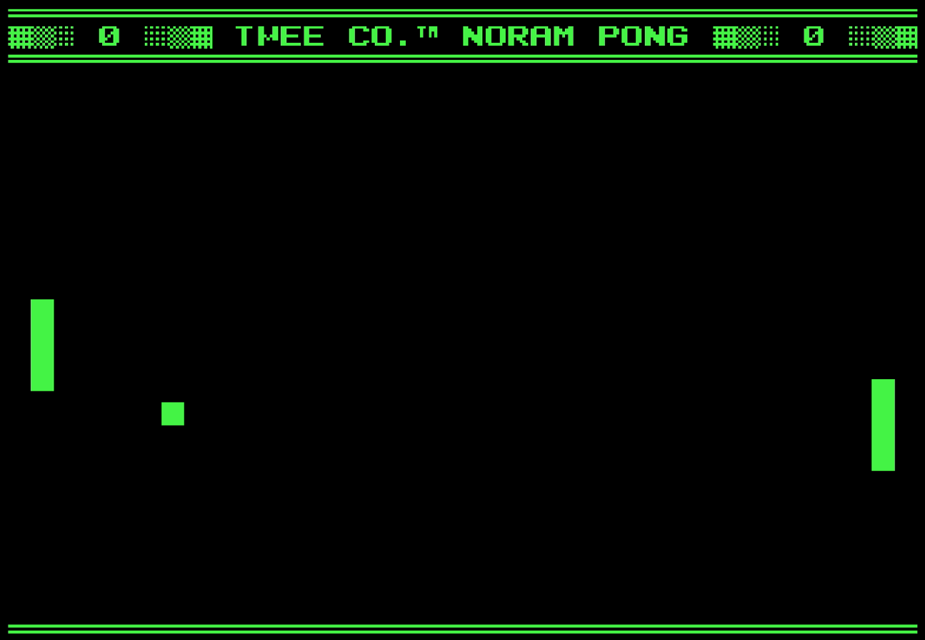
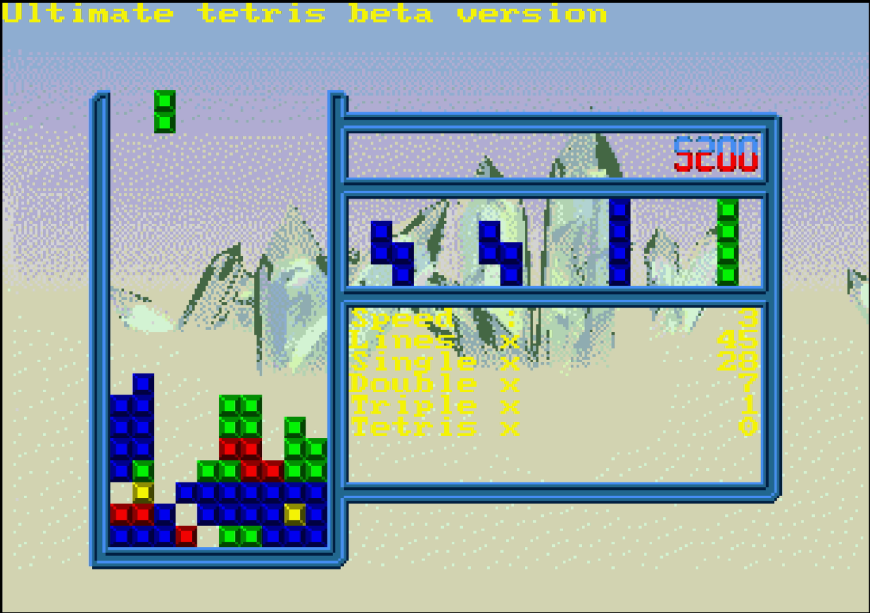
Retro Gaming on Raspberry Pi
An affordable to play games of the past, and a gateway into a world of experiences.

Slide 2
The Scenario
Say you get up one day and you decide you want to play some games from a generation past, but have no means of doing so readily available to you. Here are some of the options that may come to your head;
Purchase a new gaming console and get a service such as Nintendo Switch Online, Playstation Now, or Xbox GamePass.
Attempt to find and purchase an original version of the console you’d like to play as well as the games you want.
Purchase a “classic” console such as the NES Classic

Slide 3
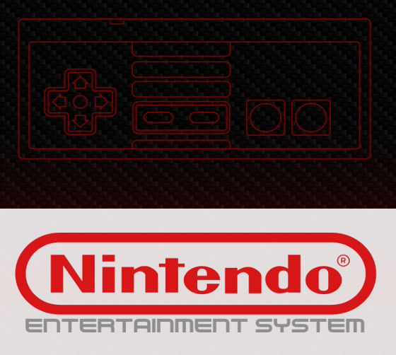
The Scenario pt 2
The thing all these options have in common, is that they can be quite pricey, and it’s a very big commitment to invest in something for the nostalgia of it all. Not to mention each one has its own added level of difficulty such as;
Stock shortages for new consoles
Limited libraries of games on services
Rarity of older consoles and games
Rarity of the “Classic” consoles which were only sold for a limited time.

Slide 4
The Scenario pt 3
This is where a GNU/Linux system comes in.
Using one of the many emulation focused Linux distributions, people who wish to have an easy-to-set-up retro game platform can play some titles made exclusively for certain consoles using a computer or a Raspberry Pi.
The options I evaluated:
RetroPie on Raspberry Pi
Downloading individual emulators on a lightweight distro such as Manjaro

Slide 5
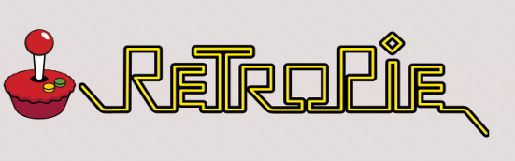
My choice: RetroPie!!
My major decision for this project was to use RetroPie with my Raspberry Pi 4 to easily emulate games from the retro eras. Some of the reasons I chose this solution were;
Future Proofing with RetroPie
Easy to start
RetroPie allows for emulation of multiple platforms
Distro is focused solely on games, similar to a console OS.

Slide 6
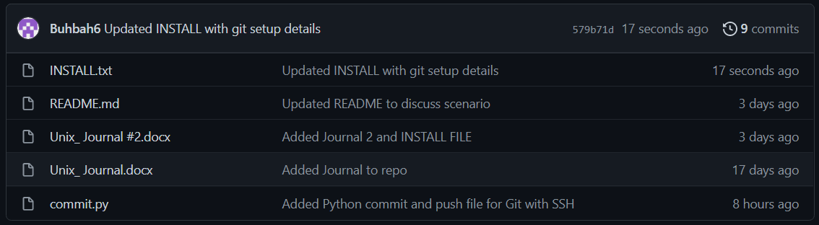
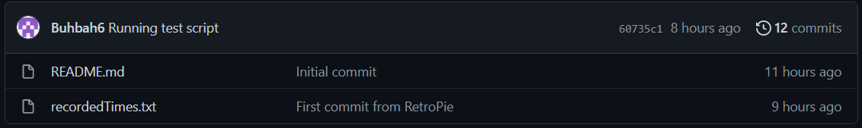
My repo: Short and to the Point

Slide 7
Automated Task
The automated task that I’ve been working on for this project, is a way to track total time spent using RetroPie.
Since RetroPie has no built-in way to track playtime, I felt that it was the best option for my automated scripts.
Boot and Shutdown scripts
Python script using the GitPython library to automatically push the file storing time to a repository.

Slide 8
Major struggles

Slide 9
Major Achievements

Slide 10
Overall Lesson

Slide 11
Q&A Time

Slide 12
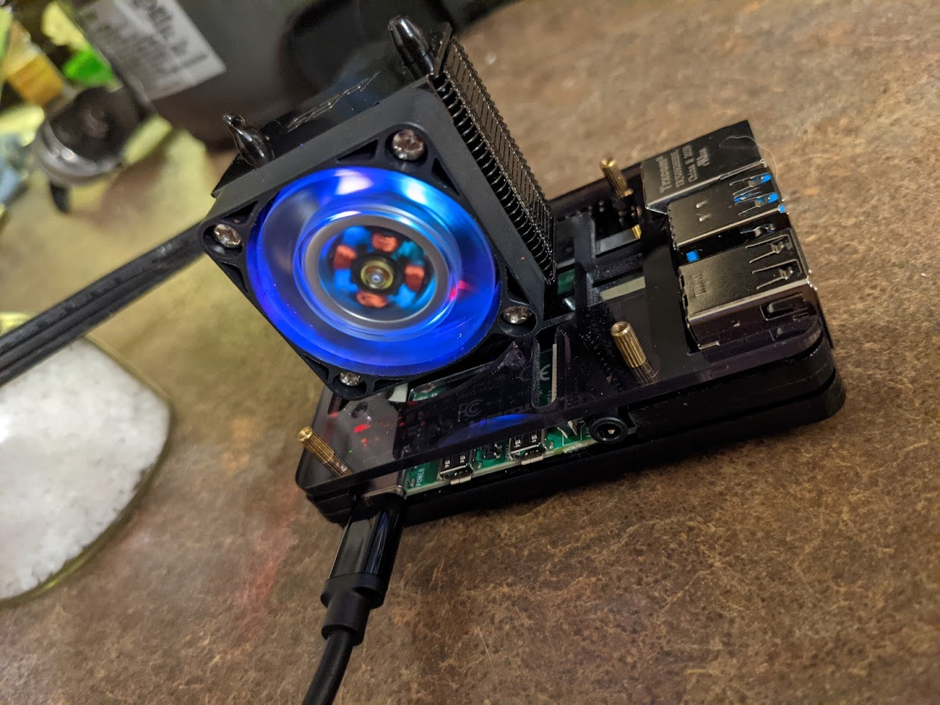
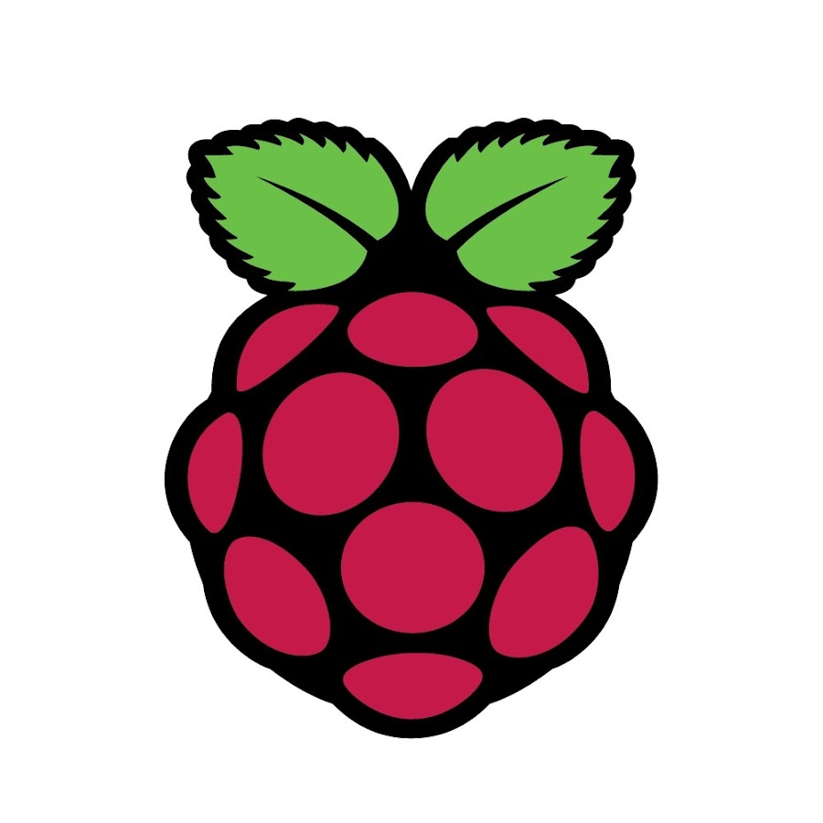
Thank you for your time!

